Slide 1
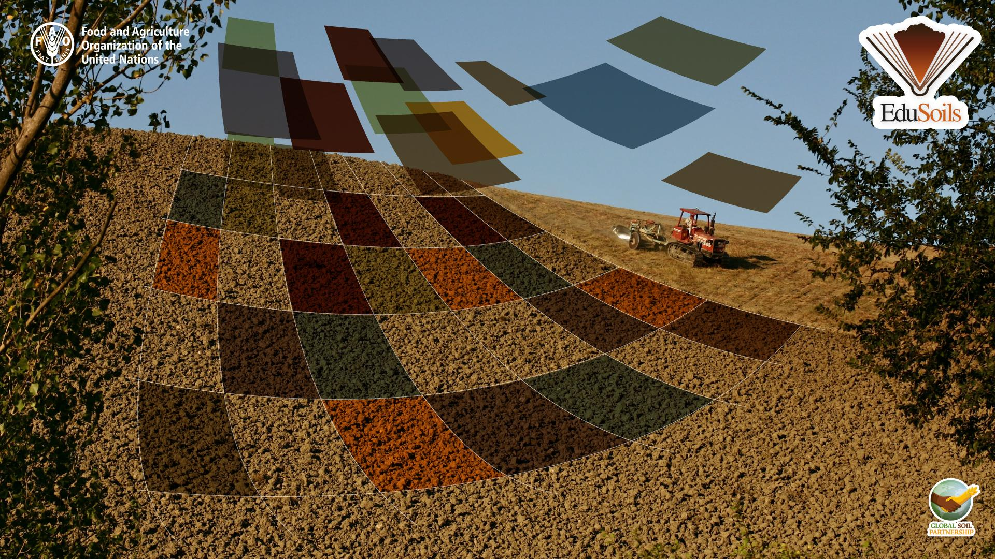
Preparation of
soil profile data
for digital soil mapping

Slide 2
Table of contents:
Introduction
Import, explore and merge soil data
Explore and clean the SOC data
Explore and clean bulk density data
Explore and clean coarse fragments data
Pedotransfer functions
Harmonize soil attributes to target depth
Calculating organic carbon stock
Transforming the data
Calculating organic carbon stock
Splitting the data
Conclusions
How to modify the script to map clay content

Slide 3
Introduction
In this course we will use the training data from the Macedonian Soil Information System Database (MASIS).
The course will provide step-by-step guidance to map soil properties, using the example of SOC stocks. Same procedure may be followed for mapping other properties (e.g. clay).
For each of the steps we will create an R script:
Preparation of soil profile data
Preparation of environmental covariates
Modelling with Regression Kriging
Modelling with Random Forest
Validation and Uncertainty

Slide 4

Let’s get started!
Open R-studio and create a new script
Save it as ‘Data preparation profiles’
Set the working directory
# Set working directory
setwd("C:/ path /training_material")
don’t forget to change the single \ to a double one \\ or to /

Slide 5
Soil Profile Data
The first task is to preparing the soil profile data
Usually, profile data comes in separate 2 tables:
A table with profile location and description;
A table with all horizons and associated soil properties;
We will have to merge these data in dataset;
Then, we will need to explore, check and clean the data!
The quality of the input data is what defines the quality of the final map!

Slide 6
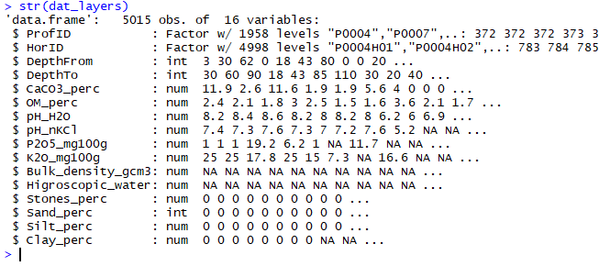
Import soil layers (horizons)
# Import soil layers (horizons) data from a .csv table
dat_layers <- read.csv(file = "01-Data/horizons.csv")
# Explore the data
str(dat_layers)
In the console you can see the ‘data frame’ structure and all the attributes that are included in the table

Slide 7
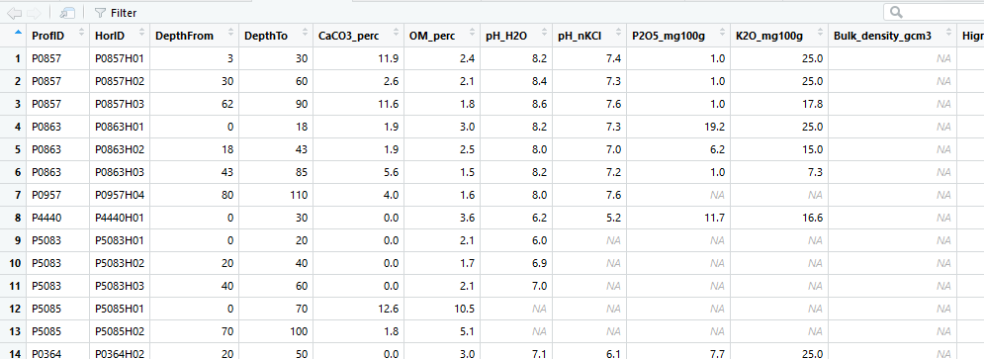
Explore soil layers (horizons)
To open the imported table you may click on the dat_layers in top-right ‘Data’ window or type:
View(dat_layers)

Slide 8
Explore soil layers (horizons)
Run the summary of dat_layers
summary(dat_layers)
Question 1: What’s the mean value of organic matter content (OM_perc)?
Question 2: How many missing values (NAs) are there in bulk density
(Bulk_density_gcm3)?
Question 3: Do you see anything unusual in the data? Any possible errors?

Slide 9
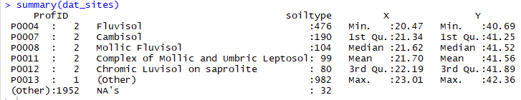
Import soil profile locations
# Import site-level data from a .csv table
dat_sites <- read.csv(file = "01-Data/site-level.csv")
# Explore the data
str(dat_sites)
summary(dat_sites)
Question: Do you see anything unusual in the data? Any possible errors?
Notes:
ProfID has 2 same IDs for several profiles

Slide 10
Remove duplicate points
Test the data for duplicate points, based on columns 1 (ProfID), 3 (X) and 4 (Y).
# Remove duplicate profiles
test <- duplicated(dat_sites[c(1,3,4)])
summary(test)
Remove duplicate points from the table
dat_sites <- dat_sites[!duplicated(dat_sites[c(1,3,4)]),]
Question: How many duplicate points are there??
Notes:
5 duplicates

Slide 11
Merging data frames
Now we can merge the horizon data with profile locations by the profile identifier (ProfID).
# Merge site-level data with soil layers (horizons) data
dat <- merge (x=dat_sites, y=dat_layers, by="ProfID")
summary(dat)
names (dat)
The new data frame (dat) has both the information about profile (soil type, X, Y), and all the data from the horizons)

Slide 12
Selecting the data for modelling
In this exercise we will model Soil Organic Carbon Stocks (OCS) for the topsoil layer of 30cm.
OCS = d * BD * SOC * CF
where: OCS = soil organic carbon stock [kg/m2 ], SOC = soil organic carbon [g / g ], d = depth class [m], BD = bulk density [kg/m3]
# Note that SOC is OM*1.724 (OM - organic matter)
dat <- data.frame(id=dat$ProfID,
X=dat$X,
Y=dat$Y,
soil=dat$soiltype,
top=dat$DepthFrom,
bottom=dat$DepthTo,
SOC=dat$OM_perc/1.724,
BLD=dat$Bulk_density_gcm3,
CRF=dat$Stones_perc)

Slide 13

Explore and clean the SOC data
# Explore and clean the SOC data
summary(dat$SOC)
We cannot use points where SOC is NA or 0. They should be removed:
dat <- dat[!is.na(dat[,"SOC"]),] # remove NA values
dat <- dat[dat$SOC>0,] # remove 0 values

Slide 14
Outliers
Outliers are data values that differ greatly from the majority of a dataset;
They can be errors, or they can be correct, but unusual values
Outliers can be formally defined using interquartile range (IQR) (difference between 1st and 3rd quartiles). If the value is 1.5 x IQR lower than 1st quartile, or 1.5 x IQR higher than 3rd quartile, then such value is an outlier.
Histograms can help to visually identify outliers
Box-plot is the best tool to identify outliers (visually and automatically)

Slide 15

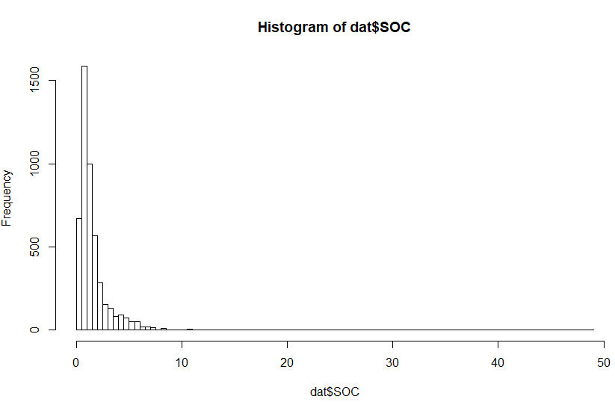
Identifying outliers
# Explore SOC data, identify outliers
summary(dat$SOC)
hist(dat$SOC, breaks=100)

Slide 16
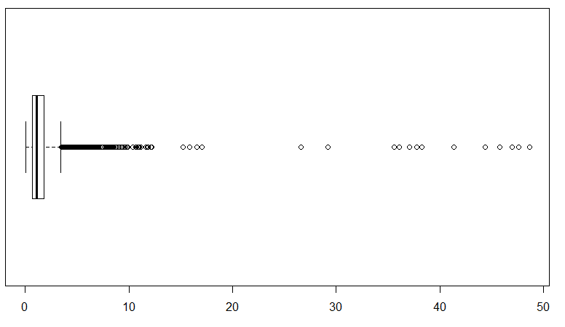
Identifying outliers with boxplot
boxplot(dat$SOC, horizontal=TRUE)
Question:
Can SOC be higher than 15% (OM>25%)?

Slide 17
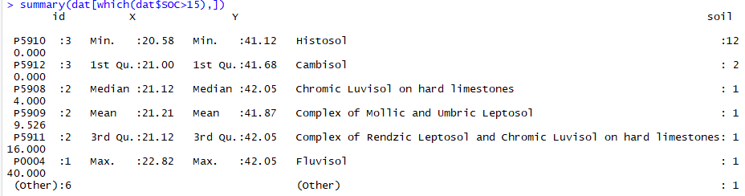
Exploring outliers
Let’s explore, which soil types have very high SOC values
unique(dat[which(dat$SOC>15), 'soil'])
# We will remove all non-histosols with atypically high SOC as outliers
dat <- dat[!( dat$SOC>15 & dat$soil!='Histosol'),]

Slide 18
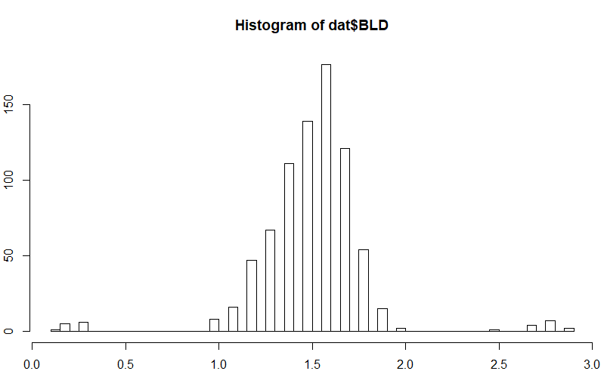
Explore bulk density data
# Explore bulk density data, identify outliers
summary(dat$BLD)
dat$BLD[dat$BLD==0]<-NA # bulk density cannot be 0, it must be NA
hist(dat$BLD, breaks=50)

Slide 19
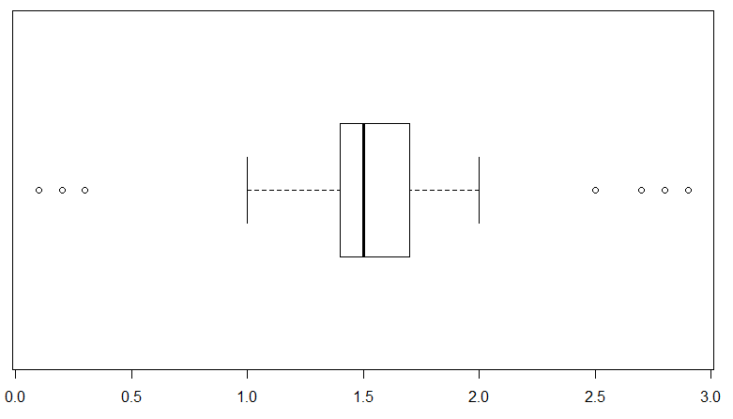
Explore bulk density data
boxplot(dat$BLD, horizontal=TRUE)$out

Slide 20
Clean bulk density data
BLD values higher than 2.5 g·cm are not typical for fine earth, and most likely correspond to coarse fragments;
These values should be removed
dat <- dat[!(dat$BLD>=2.5 & !is.na(dat$BLD)),]
BLD values lower than 1 g·cm3 can only correspond to organic soils (Histosols)
We should check if all low BLD values correspond to Histosols
summary(dat[dat$BLD<1,])
unique(dat[which(dat$BLD<1), 'soil'])

Slide 21
Clean coarse fragments data
# Explore and clean coarse fragments data
summary(dat$CRF)
hist(dat$CRF, breaks=50)
# Remove outliers automatically, using boxplot
out <- boxplot(dat$CRF, horizontal=TRUE)$out
dat <- dat[!(dat$CRF %in% out),]
# The points without CRF, should have 0 values
dat$CRF[is.na(dat$CRF)]<-0

Slide 22
Pedotransfer functions
We have many points with missing bulk density, in this case it can be estimated using pedotransfer functions
Pedotransfer functions (rules) are empirical relationships between the certain (difficult to obtain) soil properties and other (more easily obtainable) soil properties available, for example, from soil surveys.
Pedotransfer rules are based on empirical data from case-studies. If applied for soils which are different from the case study, the function should be checked on local data first.

Slide 23
Pedotransfer functions
Let’s write an R function to compare different pedotransfer rules, and choose the one that fits our local data
First, we select a testing subset of our data, where we do have BLD
# Select the best fitting pedotransfer function
BD_test <- dat[is.na(dat$BLD)==FALSE,]
estimateBD <- function(SOC, method="Saini1996"){
OM <- SOC * 1.724
if(method=="Saini1996"){BD <- 1.62 - 0.06 * OM}
if(method=="Drew1973"){BD <- 1 / (0.6268 + 0.0361 * OM)}
if(method=="Jeffrey1979"){BD <- 1.482 - 0.6786 * (log(OM))}
if(method=="Grigal1989"){BD <- 0.669 + 0.941 * exp(1)^(-0.06 * OM)}
if(method=="Adams1973"){BD <- 100 / (OM / 0.244 + (100 - OM)/2.65)}
if(method=="Honeyset_Ratkowsky1989"){BD <- 1/(0.564 + 0.0556 * OM)}
return(BD)
}

Slide 24
Selecting a pedotransfer function
We run different pedotransfer functions on the testing data
# Estimate BLD for a subset using the pedotransfer functions
BD_test$Saini <- estimateBD(BD_test$SOC, method="Saini1996")
BD_test$Drew <- estimateBD(BD_test$SOC, method="Drew1973")
BD_test$Jeffrey <- estimateBD(BD_test$SOC, method="Jeffrey1979")
BD_test$Grigal <- estimateBD(BD_test$SOC, method="Grigal1989")
BD_test$Adams <- estimateBD(BD_test$SOC, method="Adams1973")
BD_test$Honeyset_Ratkowsky <- estimateBD(BD_test$SOC, method="Honeyset_Ratkowsky1989")

Slide 25
Selecting a pedotransfer function
Now we can explore summaries of the results
# Compare results
# Observed values:
summary(BD_test$BLD)
# Predicted values:
summary(BD_test$Saini)
summary(BD_test$Drew)
summary(BD_test$Jeffrey)
summary(BD_test$Grigal)
summary(BD_test$Adams)
summary(BD_test$Honeyset_Ratkowsky)

Slide 26
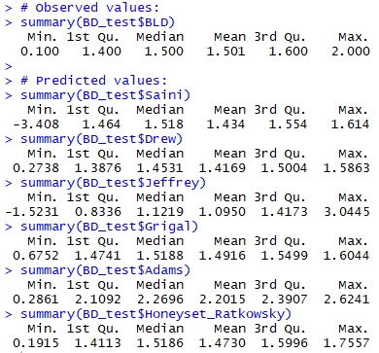
Selecting a pedotransfer function
Question 1:
Which functions have impossible or unlikely values?
Question 2:
Which functions are closer to the observed data?

Slide 27
Selecting a pedotransfer function
Let’s compare graphically!
# Compare data distributions for observed and predicted BLD
plot(density(BD_test$BLD),type="l",col="black", ylim=c(0,5), lwd=2, main="Bulk Density Pedotransfer Functions")
lines(density(BD_test$Saini),col="green", lwd=2)
lines(density(BD_test$Drew),col="red", lwd=2)
lines(density(BD_test$Jeffrey),col="cyan", lwd=2)
lines(density(BD_test$Grigal),col="orange", lwd=2)
lines(density(BD_test$Adams),col="magenta", lwd=2)
lines(density(BD_test$Honeyset_Ratkowsky),col="blue", lwd=2)
legend("topleft",legend = c("Original", "Saini", "Drew", "Jeffrey", "Grigal", "Adams","Honeyset_Ratkowsky"), fill=c("black", "green", "red", "cyan", "orange","magenta", "blue"))

Slide 28
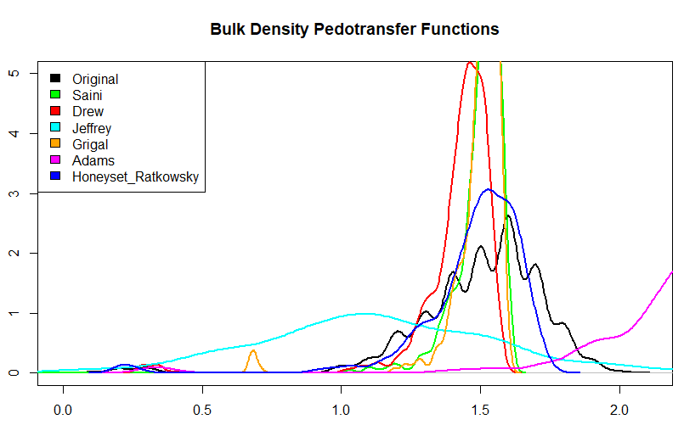

Slide 29
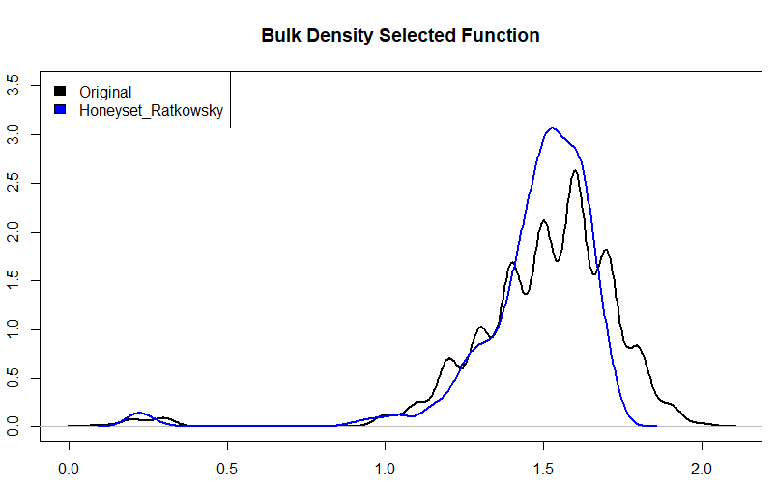
Selecting a pedotransfer function
# Plot the Selected function again
plot(density(BD_test$BLD),type="l",col="black", ylim=c(0,3.5), lwd=2, main="Bulk Density Selected Function")
lines(density(BD_test$Honeyset_Ratkowsky),col="blue", lwd=2)
legend("topleft",legend = c("Original", "Honeyset_Ratkowsky"), fill=c("black", "blue"))

Slide 30
Estimating bulk density
# Estimate BLD for the missing points with the selected function
dat$BLD[is.na(dat$BLD)] <- estimateBD(dat[is.na(dat$BLD),]$SOC, method="Honeyset_Ratkowsky1989")
# Explore the results
summary(dat$BLD)
plot(density(BD_test$BLD),type="l",col="black", ylim=c(0,3.5), lwd=2, main="Bulk Density Gap-Filling")
lines(density(dat$BLD),col="green", lwd=2)
legend("topleft",legend = c("Original", "Original+Estimated"), fill=c("black", "green"))
Question:
Does the gap-filled bulk density have a similar distribution to the original one?

Slide 31
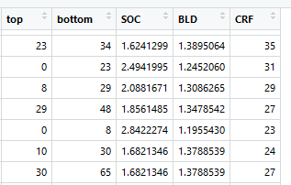
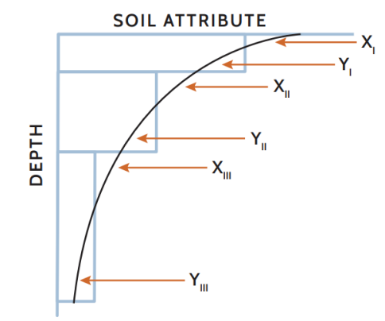
Harmonize soil attributes to target depth
Profile data has soil parameters measured for every horizon (depth layer)
We need to estimate mean value for target depth: 0-30cm
For that we can use equal-area splines. This technique is based on fitting continuous depth functions for modeling the variability of soil properties with depth.
We can use equal-area splines in with the package mpspline2

Slide 32
Harmonize soil attributes to target depth
library(mpspline2)
dat <-
dat[, c("id","top","bottom","SOC","BLD","CRF","X", "Y", "soil")]
#equal area spline SOC
SOC <-mpspline(dat, 'SOC', d = c(0,30))
temp <- data.frame()
for (i in names(SOC)){
t2 <- cbind(SOC[[i]]$id,SOC[[i]]$est_dcm[1])
temp <- rbind(temp,t2)
}
SOC <- temp

Slide 33
Harmonize soil attributes to target depth
#equal area spline BLD
BLD <-mpspline(dat, 'BLD', d = c(0,30))
temp <- data.frame()
for (i in names(BLD)){
t2 <- cbind(BLD[[i]]$id,BLD[[i]]$est_dcm[1])
temp <- rbind(temp,t2)
}
BLD <- temp

Slide 34
Harmonize soil attributes to target depth
#equal area spline CRF
CRFVOL <-mpspline(dat, 'CRF', d = c(0,30))
temp <- data.frame()
for (i in names(CRFVOL)){
t2 <- cbind(CRFVOL[[i]]$id,CRFVOL[[i]]$est_dcm[1])
temp <- rbind(temp,t2)
}
CRFVOL <- temp

Slide 35
Harmonizing the final data table
# Since we are predicting SOC we don't need Profiles without SOC data
# keep only unique ids
dat <-dat[,c("id","X", "Y", "soil") ]
dat <-dat[!duplicated(dat$id),]
#Rename columns of mpspline output
colnames(SOC) <- c('id', 'SOC')
colnames(BLD) <- c('id', 'BLD')
colnames(CRFVOL) <- c('id', 'CRF')
#Merge the harmonized SOC output with the data
dat <- merge(SOC, dat[,c("id","X", "Y", "soil") ], by='id', all.x=T)
# We are mapping SOC therefore we exclude rows with NA for the SOC column
dat <- dat[complete.cases(dat$SOC),]
dat <- dat[dat$SOC>0,]
#Finally merge the other attributes and set to numeric
dat <- merge(dat, BLD, by='id', all.x=T )
dat <- merge(dat, CRFVOL, by='id', all.x=T )
dat$SOC <- as.numeric(dat$SOC)
dat$BLD <- as.numeric(dat$BLD)
dat$CRF <- as.numeric(dat$CRF)
summary(dat)

Slide 36
Create OCSKGM function
OCSKGM <-function (ORCDRC, BLD = 1400, CRFVOL = 0, HSIZE, ORCDRC.sd = 10,
BLD.sd = 100, CRFVOL.sd = 5, se.prop = TRUE)
{ if (any(ORCDRC[!is.na(ORCDRC)] < 0) | any(BLD[!is.na(BLD)] < 0) | any(CRFVOL[!is.na(CRFVOL)] < 0))
{warning("Negative values for 'ORCDRC', 'BLD', 'CRFVOL' found")}
OCSKG <- ORCDRC/1000 * HSIZE/100 * BLD * (100 - CRFVOL)/100
if (se.prop == TRUE) {
if (any(ORCDRC.sd[!is.na(ORCDRC.sd)] < 0)) {
ORCDRC.sd = ifelse(is.na(ORCDRC.sd) | ORCDRC.sd <
0, 0, ORCDRC.sd)
warning("Replacing negative values for 'ORCDRC.sd'")}
if (any(BLD.sd[!is.na(BLD.sd)] < 0)) {
BLD.sd = ifelse(is.na(BLD.sd) | BLD.sd < 0, 0, BLD.sd)
warning("Replacing negative values for 'BLD.sd'")
} if (any(CRFVOL.sd[!is.na(CRFVOL.sd)] < 0)) {
CRFVOL.sd = ifelse(is.na(CRFVOL.sd) | CRFVOL.sd <
0, 0, CRFVOL.sd)
warning("Replacing negative values for 'CRFVOL.sd'")
} OCSKG.sd <- 1e-07 * HSIZE * sqrt(BLD^2 * (100 - CRFVOL)^2 *
ORCDRC.sd^2 + ORCDRC^2 * (100 - CRFVOL)^2 * BLD.sd^2 +
ORCDRC^2 * BLD^2 * CRFVOL.sd^2)
attr(OCSKG, "measurementError") <- signif(OCSKG.sd,
3)
attr(OCSKG, "units") <- "kilograms per square-meter"
} return(OCSKG)
}

Slide 37

Calculating organic carbon stock
OCS = d * BD * SOC * CF
where: OCS = soil organic carbon stock [kg/m2 ], SOC = soil organic carbon [g / kg ], d = depth class [cm], BD = bulk density [kg/m3]
# Estimate Organic Carbon Stock
# SOC must be in g/kg (% * 10)
# BLD in kg/m3 (*1000)
# CRF in percentage
OCSKGM <- OCSKGM(ORCDRC = dat$SOC*10, BLD = dat$BLD*1000, CRFVOL = dat$CRF, HSIZE = 30)
# Convert Organic Carbon Stock from kg/m3 to t/ha
dat$OCS <- OCSKGM*10
# Explore calculated SOC stocks
summary(dat$OCS)

Slide 38
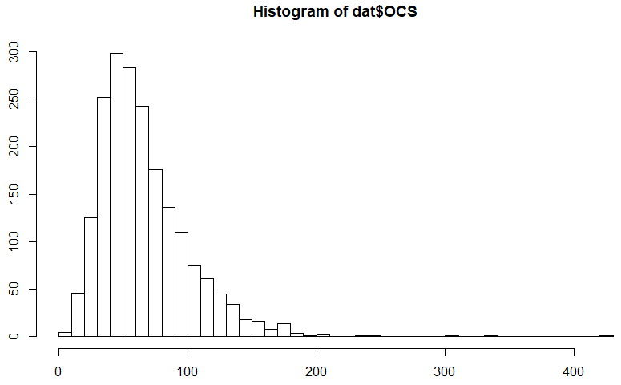
Checking the data distribution
Let’s check the distribution of our final layer
hist(dat$OCS, breaks = 50)
Question:
Is this a normal distribution?

Slide 39
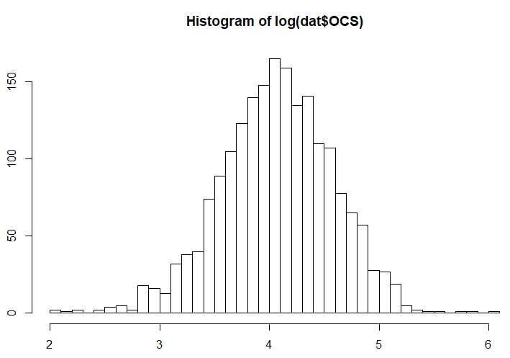
log-transforming the data
# Check if log-transformation improves # the data distribution
hist(log(dat$OCS), breaks = 50)
# Add a new column for
# log-transformed carbon stocks
dat$OCSlog <- log(dat$OCS)
# Save the final table in a .csv file
write.csv(dat, "02-Outputs/dataproc.csv", row.names = FALSE)

Slide 40
Splitting the data
When predicting soil properties, it is useful to have part of the data not used in the prediction model, so that it can be used to validate (check the accuracy) the modelling result
To have such data for validation, we will randomly split the dataset in 2 parts:
data for training the model
data for testing the model
library(caret)
# Define the random numbers table (to get reproducible result)
set.seed(11042019)
# Create random selection of 75% of the data as 'train' dataset and
# 25% as 'test' dataset
train.ind <- createDataPartition(1:nrow(dat), p = .75, list = FALSE)
train <- dat[ train.ind,]
test <- dat[-train.ind,]

Slide 41

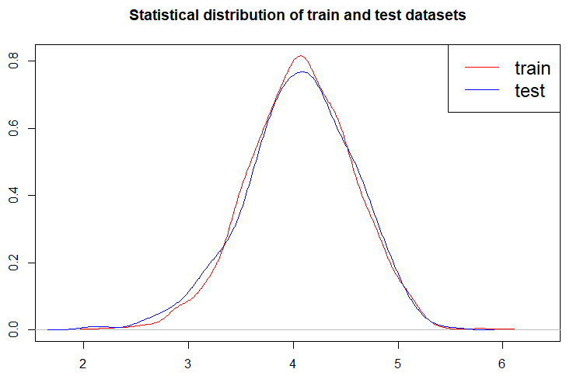
Comparing ‘train’ and ‘test’ data
# Check if both datasets
# have similar distributions
summary(train$OCS)
summary(test$OCS)
plot(density (train$OCSlog), col='red', main='Statistical distribution of train and test datasets')
lines(density(test$OCSlog),col='blue')
legend('topright', legend=c("train", "test"), col=c("red", "blue"), lty=1, cex=1.5)
# Save the 'train' and 'test' datasets
write.csv(train,file="02-Outputs/dat_train.csv", row.names = FALSE)
write.csv(test,file="02-Outputs/dat_test.csv", row.names = FALSE)

Slide 42
Conclusions
Don’t forget to save your script!
Questions:
What are main steps of preparing soil profile data for digital soil mapping?
What should you check for?

Slide 43
Conclusions
Main steps for preparing data:
Merging horisons with profile locations;
Cleaning the data (check for errors);
Filling the gaps in the data (pedotransfer functions);
Calculating the target depth (spline function);
Transforming the data (if distribution is not normal);
Splitting the data (for validating the model)

Slide 44
Conclusions
Things to check for:
Duplicate points
NA values
0 values
Outliers
Validity of pedotransfer functions
Data distribution

Slide 45
Steps needed to
prepare the data to map clay

